Slide 1

UNIT III
FORMAL LANGUAGES AND REGULAR GRAMMARS

Slide 2
UNIT III SYLLABUS
FORMAL LANGUAGES AND REGULAR GRAMMARS : Definition of a Grammar, Languages Generated by a Grammar, Chomsky Classification of Languages, Recursive and Recursively Enumerable Sets, Languages and Automata, Chomsky hierarchy of Languages, REGULAR GRAMMARS: Regular Sets and Regular Grammars, Converting Regular Expressions to Regular Grammars, Converting Regular Grammars to Regular Expressions, Left Linear and Right Linear Regular Grammars

Slide 3
Grammar
A Grammar is a 4-tuple such that-
G = (V , T , P , S) where-
V = Finite non-empty set of non-terminal symbols
T = Finite set of terminal symbols
P = Finite non-empty set of production rules
S = Start symbol

Slide 4
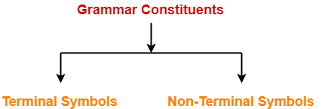
A Grammar is mainly composed of two basic elements-
1. Terminal symbols
2. Non-terminal symbols

Slide 5
1. Terminal Symbols-
Terminals are the basic symbols from which strings are formed.
Terminal symbols are denoted by using small case letters such as a, b, c etc.
2. Non-Terminal Symbols-
Non-terminals are syntactic variables that denote sets of strings.
The non-terminals define sets of strings that help define the language generated by the grammar.
Non-Terminal symbols are also called as auxiliary symbols or variables.
Non-Terminal symbols are denoted by using capital letters such as A, B, C etc.

Slide 6
REGULAR GRAMMAR
A regular grammar is a formal grammar that is right-regular or left-regular.
Every regular grammar describes a regular language.

Slide 7
TYPES
Right linear regular grammar
Left linear regular grammar

Slide 8
Right Linear Regular Grammar
A right regular grammar (also called right linear grammar) is a formal grammar (N, Σ, P, S) such that all the production rules in P are of one of the following forms:
A → a, where A is a non-terminal in N and a is a terminal in Σ
A → aB, where A and B are non-terminals in N and a is in Σ
A → ε, where A is in N and ε denotes the empty string, i.e. the string of length 0.

Slide 9
Left Linear Regular Grammar
In a left regular grammar (also called left linear grammar), all rules obey the forms:
A → a, where A is a non-terminal in N and a is a terminal in Σ
A → Ba, where A and B are in N and a is in Σ
A → ε, where A is in N and ε is the empty string.
A regular grammar is a left or right regular grammar.

Slide 10
Example-01:
Consider a grammar G = (V , T , P , S) where-
V = { S } // Set of Non-Terminal symbols
T = { a , b } // Set of Terminal symbols
P = { S → aSbS , S → bSaS , S → ∈ } // Set of production rules
S = { S } // Start symbol
This grammar generates the strings having equal number of a’s and b’s

Slide 11
Example-02:
Construct right and left linear grammars for the language, L={a^n b^m, n>=2, m>=3}

Slide 12
Language Generated by a Grammar
The set of all strings that can be derived from a grammar is said to be the language generated from that grammar.
A language generated by a grammar G is a subset formally defined by
L(G)={W|W ∈ ∑*, S ⇒G W}
If L(G1) = L(G2), the Grammar G1 is equivalent to the Grammar G2.

Slide 13
Example 1
If there is a grammar
G: N = {S, A, B} T = {a, b} P = {S → AB, A → a, B → b}
Here S produces AB, and we can replace A by a, and B by b. Here, the only accepted string is ab, i.e., L(G) = {ab}

Slide 14
Example 2
Suppose we have the following grammar −
G: N = {S, A, B} T = {a, b} P = {S → AB, A → aA|a, B → bB|b}
The language generated by this grammar −
L(G) = {ab, a²b, ab², a²b², ………}
= {a^{m} b^{n} | m ≥ 1 and n ≥ 1}

Slide 15
PRACTICE QUESTIONS
Suppose, L (G) = {a^{m} b^{n} | m ≥ 0 and n > 0}. We have to find out the grammar G which produces L(G).
2. Suppose, L (G) = {a^{m} b^{n} | m > 0 and n ≥ 0}. We have to find out the grammar G which produces L(G).

Slide 16
POLLING QUESTIONS
1. Which type of grammar is it?
S → abS|S → a
a) Right Linear Grammar
b) Left Linear Grammar
c) Right & Left Linear Grammar
d) None of the mentioned
Notes:
a

Slide 17
2. Which of the following String can be obtained by the language L = {a^i b^2i | i >=1}?
a) aaabbbbbb
b) aabbb
c) abbabbba
d) aaaabbbabb
Notes:
a

Slide 18
3. Let the class of language accepted by finite state machine be L1 and the class of languages represented by regular expressions be L2 then?
a) L1<l2
b) L1>=L2
c) L1 U L2 = .*
d) L1=L2
Notes:
d

Slide 19
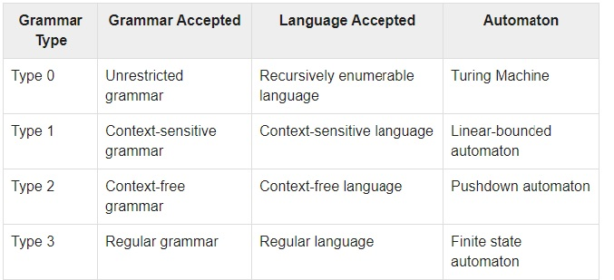
Chomsky Classification of Grammars
According to Noam Chomosky, there are four types of grammars − Type 0, Type 1, Type 2, and Type 3.

Slide 20
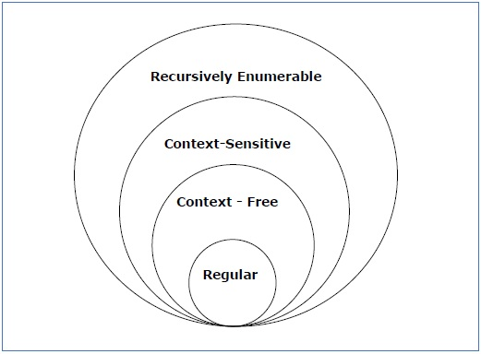
Scope of Each Grammar

Slide 21
Type - 3 Grammar
Type-3 grammars generate regular languages. Type-3 grammars must have a single non-terminal on the left-hand side and a right-hand side consisting of a single terminal or single terminal followed by a single non-terminal.
The productions must be in the form
X → a or X → aY
where X, Y ∈ N (Non terminal) and a ∈ T (Terminal)
The rule S → ε is allowed if S does not appear on the right side of any rule.

Slide 22
Example
X → ε
X → a | aY
Y → b

Slide 23
Type - 2 Grammar
Type-2 grammars generate context-free languages.
The productions must be in the form
A → γ
where A ∈ N (Non terminal) and γ ∈ (T ∪ N)* (String of terminals and non-terminals).
These languages generated by these grammars are be recognized by a non-deterministic pushdown automaton.

Slide 24
Example
S → X a
X → a
X → aX
X → abc
X → ε

Slide 25
Type - 1 Grammar
Type-1 grammars generate context-sensitive languages. The productions must be in the form
α A β → α γ β
where A ∈ N (Non-terminal) and α, β, γ ∈ (T ∪ N)* (Strings of terminals and non-terminals)
The strings α and β may be empty, but γ must be non-empty.
The rule S → ε is allowed if S does not appear on the right side of any rule. The languages generated by these grammars are recognized by a linear bounded automaton.

Slide 26
Example
AB → AbBc
A → bcA
B → b

Slide 27
Type - 0 Grammar
Type-0 grammars generate recursively enumerable languages. The productions have no restrictions. They are any phase structure grammar including all formal grammars.
They generate the languages that are recognized by a Turing machine.
The productions can be in the form of
α → β
where α is a string of terminals and nonterminals with at least one non-terminal and α cannot be null. β is a string of terminals and non-terminals.

Slide 28
Example
S → ACaB
Bc → acB
CB → DB
aD → Db

Slide 29
POLLING QUESTIONS
Regular expression is __________
a) Type 0 language
b) Type 1 language
c) Type 2 language
d) Type 3 language
Notes:
a

Slide 30
2. Which of the following strings is not generated by the following grammar?
S → SaSbS|ε
a) aabb
b) abab
c) aababb
d) aaabbb
Notes:
d

Slide 31
3. What is the Regular Expression Matching Zero or More Specific Characters
a) x
b) #
c) *
d) &
Notes:
C

Slide 32
4. The production Grammar is {S->aSbb,S->abb} is
a) Type-3 grammar
b) Type-2 grammar
c) Type-1 grammar
d) Type-0 grammar
Notes:
b

Slide 33
5. Regular expression (x|y)(x|y) denotes the set
a) {xy,xy}
b) {xx,xy,yx,yy}
c) {x,y}
d) {x,y,xy}
Notes:
b

Slide 34
6. Consider the following regular expression
R = ( ab + abb )* bbab
Which of the following is not a set denoted by R?
A) abababab
B) ababbabbbab
C)abbbab
D)abbabbbab.
Notes:
A

Slide 35
7. Every grammar in Chomsky Normal Form is:
a) regular
b) context sensitive
c) context free
d) all of the mentioned
Notes:
c

Slide 36
Conversion of RE to Regular Grammar
Convert the given RE=(a+b)* aa (a+b)* into its equivalent CFG.
Convert the given RE=0*1 (0+1)* into its equivalent CFG.

Slide 37
Practice Questions
Convert the following RE into CFG:
a*
a+0
(ab)*
a* + 1 + b+
0*(1 (0+1))*

Slide 38
Polling Questions
1. Which of the following strings is not generated by the following grammar?
S → SaSbS|ε
a) aabb
b) abab
c) aababb
d) aaabbb
Notes:
d

Slide 39
2. What is the highest type number which can be applied to the following grammar ?
S —> Aa, A —> Ba, B —> abc
A.Type 0
B.Type 1
C.Type 2
D.Type 3
Notes:
c

Slide 40
3. The context free grammar
S → A111|S1, A → A0 | 00 is equivalent to
a) {0ⁿ1ᵐ | n=2, m=3}
b) {0ⁿ1ᵐ | n=1, m=5}
c) {0ⁿ1ᵐ | n should be greater than two and m should be greater than four}
d) None of these
Notes:
a

Slide 41
Conversion of Regular Grammar to RE
Given grammar: S->b|AA, A->Aa|Abb|e. Convert into its equivalent RE.
Given grammar: S->AS|a, A->SA|b. Convert into its equivalent RE.

Slide 42
1.The CFG
S---> aS | bS | a | b
is equivalent to regular expression
A.(a + b)
B.(a + b) (a + b)*
C.(a + b) (a + b)
D.None of these
Notes:
B

Slide 43
2. Consider the grammar :
S —> ABCc | Abc
BA —> AB
Bb —> bb
Ab —> ab
Aa —> aa
Which of the following sentences can be derived by this grammar :
A.abc
B.aab
C.abcc
D.abbb
Notes:
A

Slide 44
3. Any string of terminals that can be generated by the following CFG is
S-> XY
X--> aX | bX | a
Y-> Ya | Yb | a
A.has atleast one 'b‘
B.should end in a 'a‘
C.has no consecutive a's or b's
D.has atleast two a's
Notes:
D

Slide 45
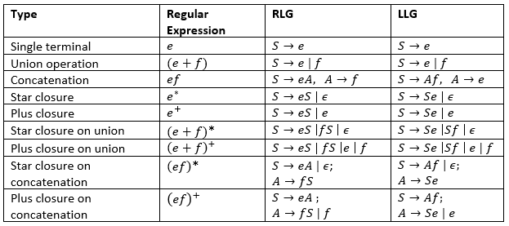
Rules to convert regular expressions to left or right linear regular grammar

Slide 46
POLLING QUESTIONS
The regular expression representing the set of all strings over {X, Y} ending with XX and beginning with Y is
XX ( X + Y )* Y
YY ( X + Y )* X
Y ( X + Y)* XX
Y (XY)* XX.
Notes:
C

Slide 47
2. Which of the following grammars generates strings with any number of 1’s?
S ->1A, A -> ε
S -> 1S, S -> ε
S -> S1, S ->ε
Both B) and C)
Notes:
A

Slide 48
3. Consider the grammar:
S -> aSAb | ε; A -> bA | ε;
The grammar generates strings in the form a^ib^j for some i, j >=0. What are the conditions for i & j?
i = j
j <= 2i
j >= 2i
i <= j
Notes:
C,D

Slide 49
4. The string 1101 does not belong to the set represented by
110*(0+1)
1(0+1)*101
(10)*(01)*(00+11)*
(00+(11)*01)*
Notes:
C

Slide 50
5. The following CFG:
S -> aB | bA
A -> b | aS | Baa
B-> a | bS | aBB
generates strings that have:
Equal number of a’s and b’s
Odd number of a’s and odd number of b’s
Even number of a’s and even number of b’s
None of the above
Notes:
d

Slide 51
6. Consider the Grammar, G, with the production rule:
S ->SS | SaS | aSb | bSa | ε
If S is the Start Variable, then which of the following is not generated by G?
abab
aaab
abbaa
babba
Notes:
d

